Slide 1
Real Estate Sales Dashboard
2001- 2020

Slide 2
Objectives
Assessment Accuracy Evaluate the accuracy of property assessments by comparing assessed values with actual sale amounts, and identify any discrepancies.
Market Trends Analyze sales ratios to uncover trends in property market values, understanding how sale amounts relate to the assessed values across different property types and residential classifications.
Geographical Analysis Investigate variations in assessed values, sales amounts, and market ratios across different towns, providing a localized understanding of real estate dynamics.
Property Type Impact Examine the impact of property type on assessment accuracy and market trends, exploring whether certain types (e.g., residential, commercial) exhibit distinct patterns.
Non-Use Code Insights Explore the significance of non-use codes in property assessment, investigating how these codes influence assessed values and sales transactions.
Assessor and OPM Remarks Analyze remarks provided by assessors and the Office of Policy and Management (OPM) to identify factors influencing assessment decisions and potential areas for improvement.

Slide 3
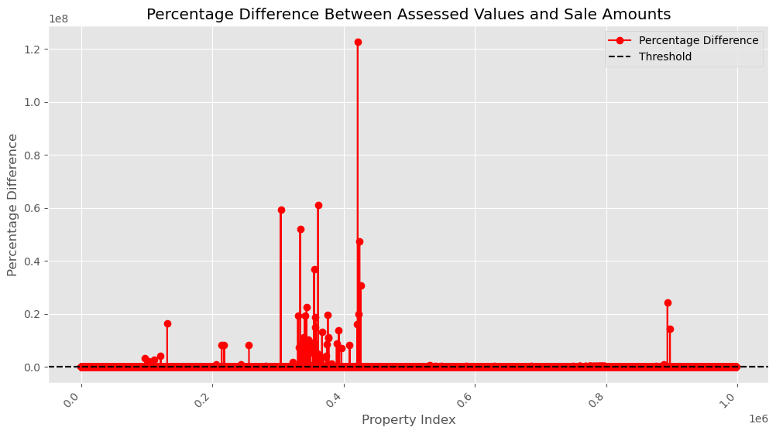
The above chart shows the percentage difference between the Assessed Value and Actual Sale Amount of each Property. The Discrepancy went as high as above 1.2%

Slide 4
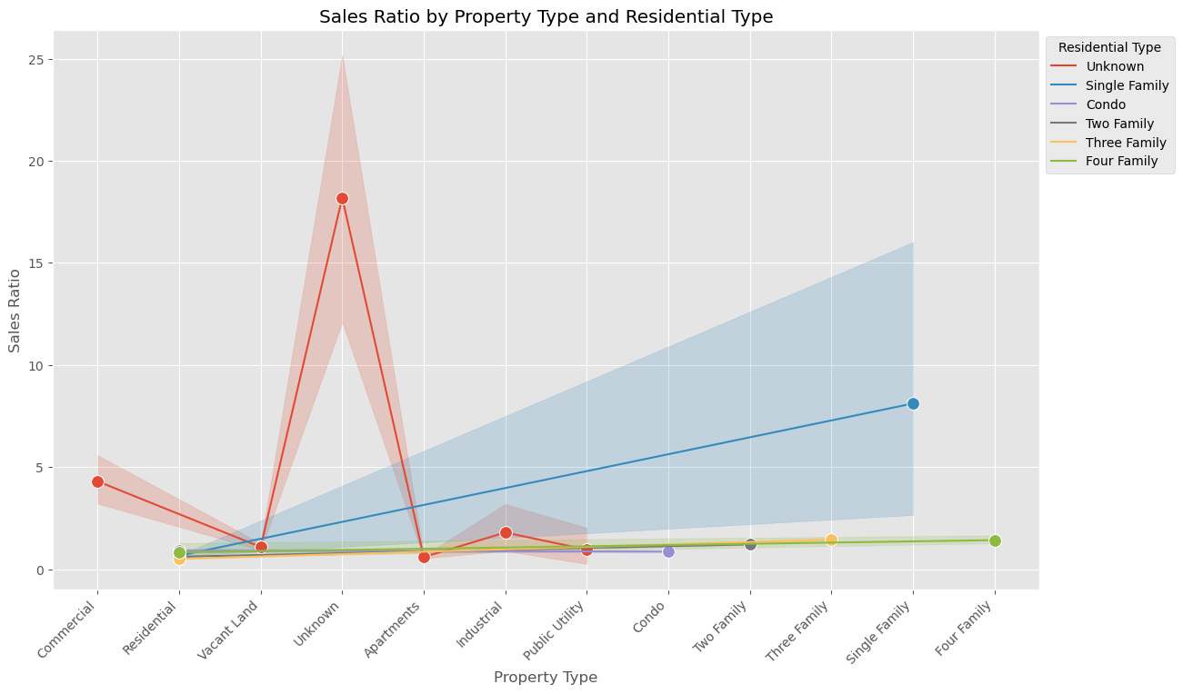
Using the Sales Ratio to get the Market Trend for the Residential Type, there is a significant increase in the ratio for Residential Type- 'Unknown' as sufficient data was not provided

Slide 5
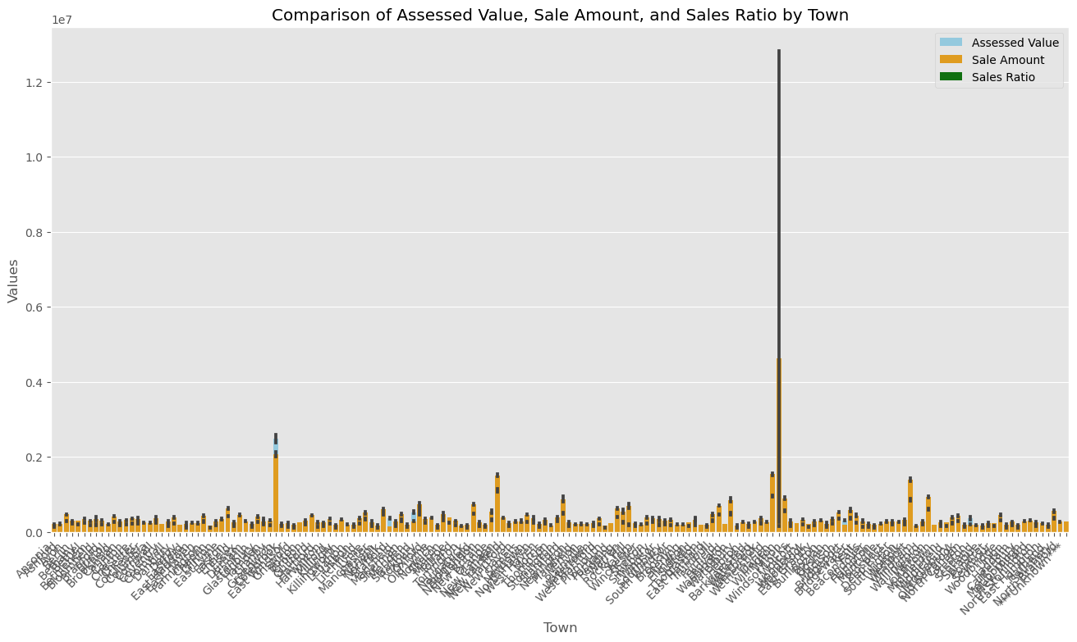

Slide 6
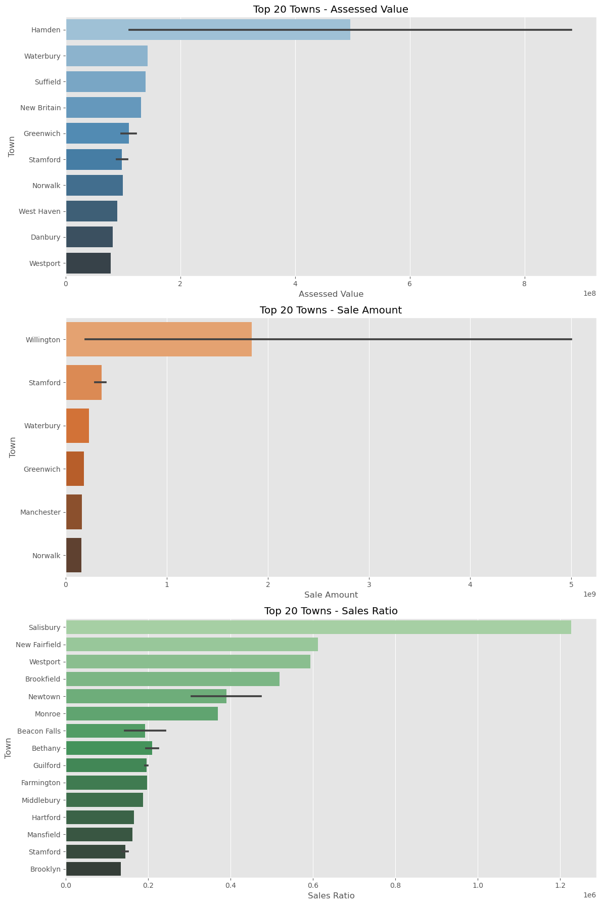
Using the Top 20 Towns to investigate the variations in Assessed Value, Sale Amount and Market Ratio, The above shows that Hamden is the highest in terms of Assessed Value, Willington is the highest in terms of Sale Amount and Salisbury is the highest in terms of Sales Ratio. This clearly shows that there is a great discrepancy between the Assessed Value and Actual Sale Amount.

Slide 7
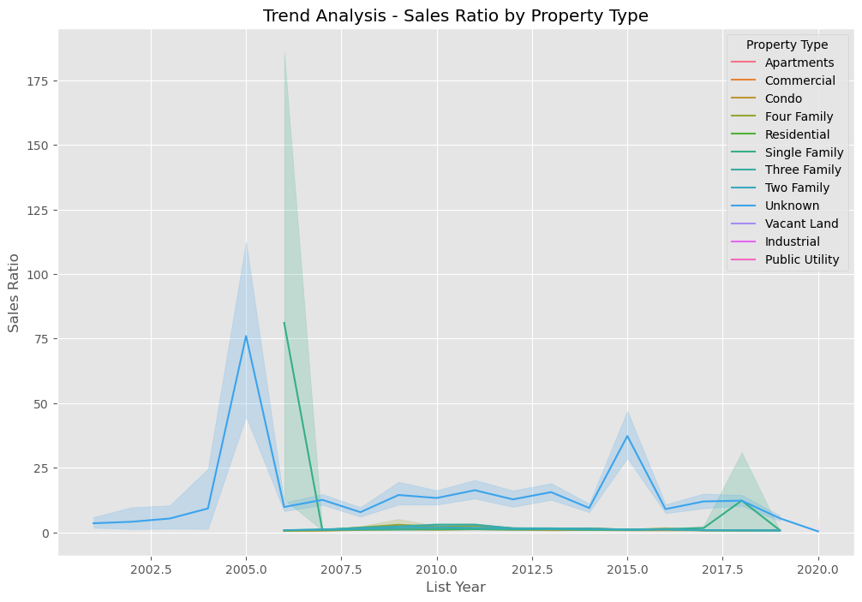
Residential and Unknown Property Type have the highest Sales Ratio

Slide 8
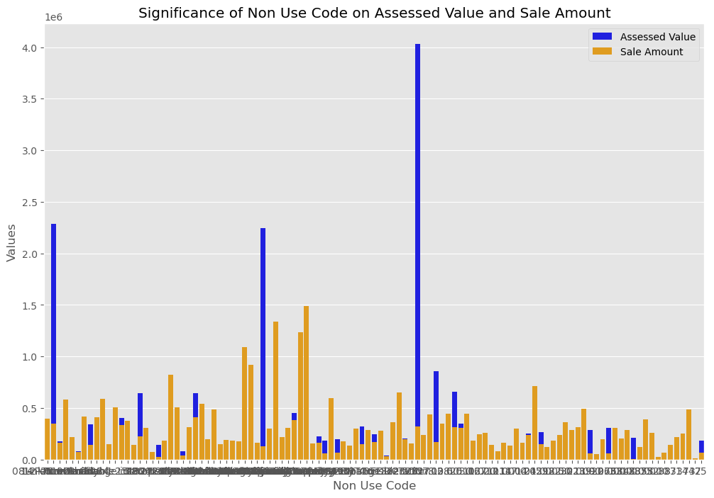

Slide 9
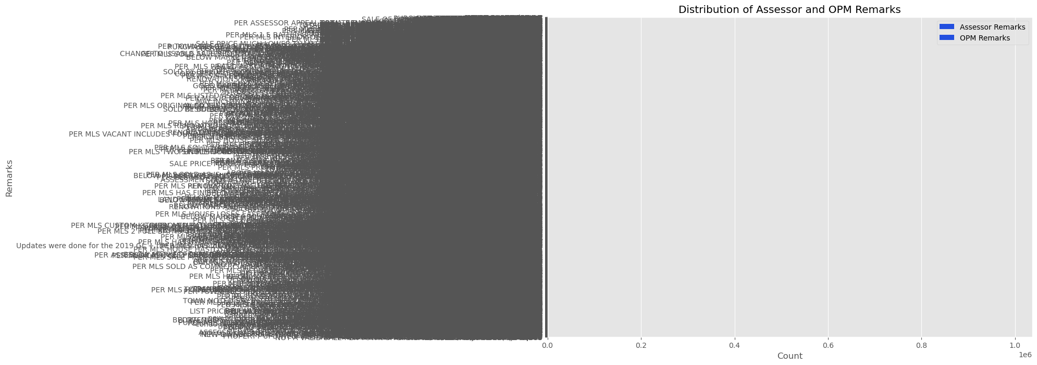

Slide 10
Recommendation:
The OPM and Assessor Remarks will need to be critically assessed and if possible proper training provided so that going forward Property Assessment done will be near accurate with little or no error at all.

